Slide 1
Presentation on Hodgkin’s lymphoma
GROUP MEMBERS
NAMES | SURNAMES | GC#
MAMADOU JANG O | BAH | 2431042
DEMBA A | JANNEH | 2431067
ALIEU | JAMMEH | 2431147
SAINABOU | BASS | 2431149
AMIE | CHAM | 2431096
ANIOKE PRECIOUS | CHIOMA | 2431129
ABDOULIE | DAMPHA | 2431018
MAMADOU S | BAH | 2431094
ALASANA | DARBOE | 2431009

Slide 2
Presentation outlines
Introduction or Overview of the topic
Definition(s)
Aetiology
Pathophysiology
Types
Signs and symptoms
Investigations
Medical/ nursing management
Nursing diagnosis
Complications
Differentials diagnosis
⁠Refrences

Slide 3
INTRODUCTION
Hodgkin lymphoma is a dangerous type of cancer that affects the lymphatic system, the lymphatic system plays an important role in protecting the body against infections and diseases. The disease commonly starts in the lymph nodes and can spread to other parts of the body if not treated. It can affect people of different ages, but it is more common in young adults and older adults. With early diagnosis and appropriate treatment, Hodgkin lymphoma can often be treated successfully.

Slide 4
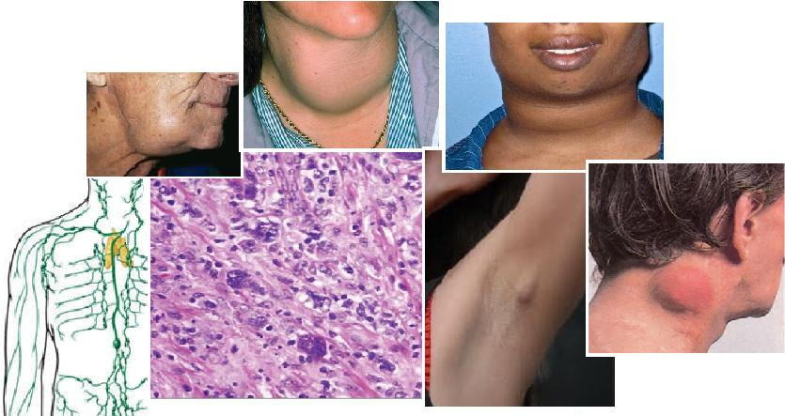

Slide 5
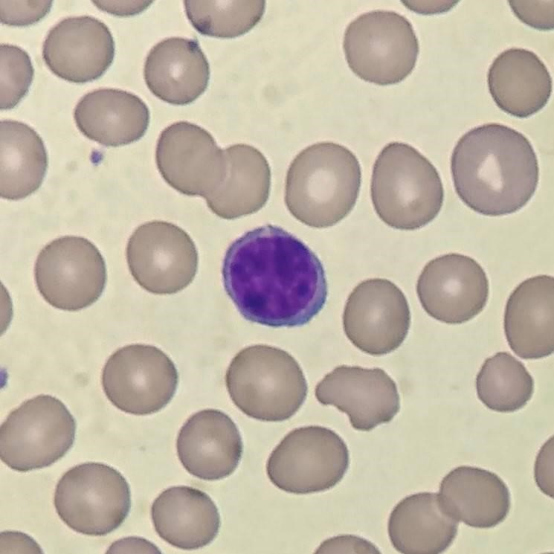
DEFINITION
Hodgkin lymphoma is a malignant cancer of the lymphatic system characterized by the abnormal growth of lymphocytes and the presence of abnormal cells called Reed Sternberg cells .It usually begins in the lymph nodes, causing them to become enlarged, and may spread to other lymph nodes or organs such as the spleen, liver, lungs, or bone marrow.

Slide 6
AETIOLOGY
Hodgkin lymphoma has no exact known cause and is considered multifactorial. Important factors include
Genetic susceptibility
Immune dysfunction
immunosuppression.
Family history
HIV/AIDS
Transplantation
Autoimmune diseases can increase risk

Slide 7
CONT
lymphoma has a bimodal age distribution, commonly affecting young adults aged 15–35 and people over 55. It is slightly more common in males. Reed-Sternberg cells are abnormal malignant B lymphocytes that escape apoptosis and immune surveillance. Socioeconomic and environmental factors may also influence disease development.

Slide 8
Pathophysiology
Hodgkin lymphoma is a malignant cancer of the lymphatic system that usually develops from abnormal B lymphocytes. The characteristic cells are Reed–Sternberg cells, which release cytokines and attract inflammatory cells, causing painless lymph-node enlargement (lymphadenopathy). The disease usually spreads from one lymph-node group to nearby groups and may later affect the spleen, bone marrow, or other organs. Advanced disease may cause anemia and other blood-cell abnormalities and it’s classified in to two types.

Slide 9
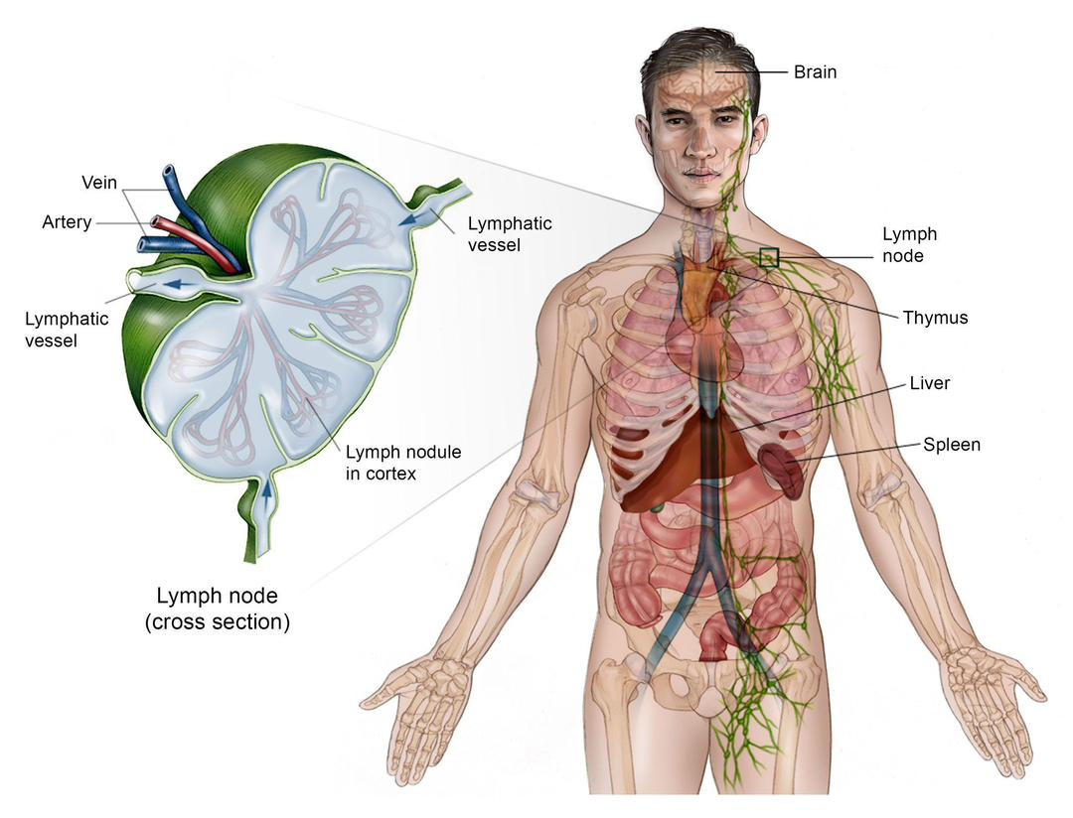

Slide 10
Types
Classic Hodgkin Lymphoma (cHL) about 95%: It is characterized by classic Reed–Sternberg cells and has four subtypes:
nodular sclerosis, the most common and often affecting young adults;
mixed cellularity, commonly associated with EBV;
lymphocyte-rich, which usually has a favorable prognosis; and
lymphocyte-depleted, the rarest and often associated with advanced disease.
Nodular Lymphocyte-Predominant Hodgkin Lymphoma (NLPHL) about 5%: It contains popcorn (LP) cells instead of classic Reed–Sternberg cells. It is usually slow-growing and localized to lymph nodes.

Slide 11
Signs and symtoms
Painless enlarged lymph nodes, especially in the neck, armpits, or groin
Fever
Drenching night sweats
Unexplained weight loss
Severe or persistent tiredness
Generalized itching
Loss of appetite
Cough or difficulty breathing when lymph nodes in the chest are enlarged
Pain in enlarged lymph nodes after drinking alcohol (but not that much common).

Slide 12
Investigation
1. Confirm the diagnosis
Physical examination: Check for enlarged lymph nodes, spleen, and liver.
Lymph node biopsy: Gold standard. The tissue is examined for Reed–Sternberg cells.
2. Blood tests
CBC: Checks red cells, white cells, and platelets.
ESR and LDH: May be elevated.
Liver and kidney tests: Assess organ function.

Slide 13
Cont’n
3. Imaging for staging
CT scan: Shows enlarged lymph nodes and affected organs.
Chest X-ray/MRI: Used when necessary.
4. Bone marrow test
May be done to check for bone marrow involvement.
5. Before treatment
HIV/hepatitis tests, pregnancy test, heart/lung assessment, and fertility evaluation when needed.

Slide 14
Medical/nursing management
Medical Management of Hodgkin Disease
Chemotherapy – main treatment for many patients.
Radiotherapy – used to destroy remaining cancer cells.
Immunotherapy – helps the immune system attack cancer cells.
Targeted therapy – targets specific cancer cells.
Stem-cell transplant – may be used when the disease returns or does not respond to treatment.
Supportive treatment – pain relief, anti-nausea medicines, antibiotics when needed, and blood transfusion if necessary.

Slide 15
Nursing management
Monitor vital signs regularly.
Observe for signs of infection.
Maintain strict infection-control measures.
Monitor for chemotherapy side effects.
Assess and manage pain.
Manage nausea and vomiting.
Encourage adequate nutrition and fluids.
Encourage adequate rest and manage fatigue.
Educate the patient about treatment and self-care.
Encourage regular follow-up appointments.

Slide 16
Nursing diagnosis
Risk for infection related to immunosuppression and chemotherapy.
Fatigue related to anaemia and disease processes.
Imbalanced nutrition: Less than body requirements related to anorexia.
Acute pain related to enlarged lymph nodes.
Anxiety related to diagnosis and uncertainty about prognosis.
Risk for bleeding related to thrombocytopenia
Disturbed body image related to hair loss and physical changes.

Slide 17
complications
Infections: A weakened immune system and chemotherapy increase the risk of bacterial, viral, and fungal infections.
Anemia: Reduced red blood cells can cause fatigue, weakness, pallor, dizziness, and shortness of breath.
Thrombocytopenia: Low platelet levels increase the risk of easy bruising, nosebleeds, gum bleeding, and prolonged bleeding.
Bone marrow suppression: Chemotherapy can reduce blood-cell production, leading to anemia, neutropenia, and thrombocytopenia.
Respiratory complications: Enlarged chest lymph nodes may compress the airways, causing cough, chest discomfort, and difficulty breathing.
Superior vena cava syndrome: Compression of the superior vena cava may cause swelling of the face, neck, or arms, headache, and shortness of breath.
Liver and spleen involvement: Advanced disease may cause hepatomegaly, splenomegaly, abdominal discomfort, and abnormal liver function

Slide 18
Differential Diagnosis
Non-Hodgkin lymphoma
Tuberculous lymphadenitis
Chronic lymphocytic leukaemia (CLL)
Acute lymphoblastic leukaemia (ALL)
Metastatic lymph node cancer
Reactive lymphadenopathy
Castleman disease

Slide 19
References
National Cancer Institute. (2025). Hodgkin lymphoma treatment (PDQ®): Patient version. National Institutes of Health. NCI: Hodgkin Lymphoma Treatment⁠
National Cancer Institute. (2025). Hodgkin lymphoma treatment (PDQ®): Health professional version. National Institutes of Health. NCI: Health Professional Version⁠
American Cancer Society. (2025). Hodgkin lymphoma. American Cancer Society: Hodgkin Lymphoma⁠￼
American Cancer Society. (2025). Tests for Hodgkin lymphoma. American Cancer Society: Tests for Hodgkin Lymphoma⁠
American Cancer Society. (2025). Signs and symptoms of Hodgkin lymphoma. American Cancer Society: Signs and Symptoms⁠￼
American Cancer Society. (2025). Treating Hodgkin lymphoma.

